Slide 1

Airline Reservation
System
Owner:
Haider Sultan 2021-CS-85
Developer:
Uswa Arif 2021-CS-77

Slide 2

01
Project Overview
06
Best Practices
CONTENTS
02
Technology Stack
07
Project Features
03
Wireframes
08
Project Management Tools
04
Frontend
09
Communication with Owner
05
Backend
10
GitHub Repository

Slide 3
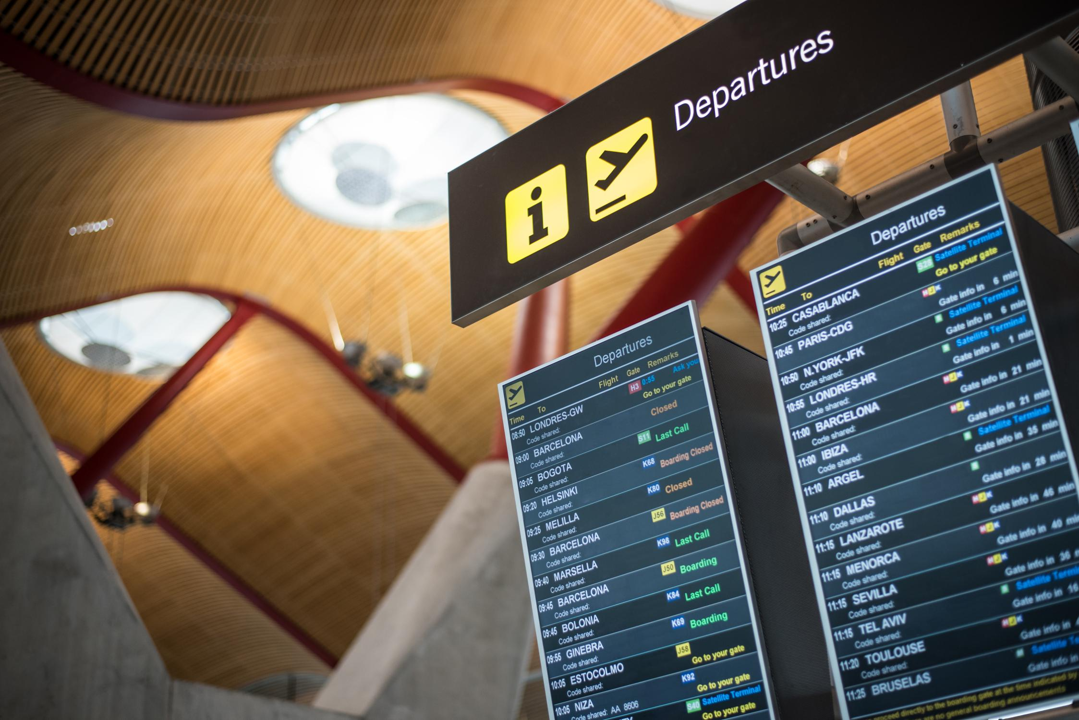
Project Overview
The proposed Airplane Reservation System represents an advanced solution designed to streamline flight bookings in Pakistan. With a primary focus on user convenience, the system seeks to simplify the entire travel experience. It begins with a user-friendly registration process, ensuring the authenticity of user information. Offering a comprehensive array of functionalities, users can effortlessly search for available flights, book tickets, select seats, and receive automated confirmation emails after successful bookings.

Slide 4
Technology Stack
Frontend
Flutter
Dart
Backend
Dart
Firebase

Slide 5
Reason for Technology Stack
Frontend - Flutter & Dart:
Cross-Platform Development
Flutter's cross-platform framework allows for building native applications for both Android and iOS platforms using a single codebase.
Rich User Interfaces Using Dart
Dart, the programming language for Flutter, offers reactive and modern approach simplifies UI development, enabling the responsive user interfaces.
Backend - Dart & Firebase:
Real-time Capabilities of Firebase
Firebase, with its real-time database, ensures instant data synchronization across clients. This feature is vital for managing interactions within the system.
Authentication and Security
Firebase offers robust authentication services, safeguarding user credentials and ensuring secure access control.

Slide 6
Wireframes

Slide 7
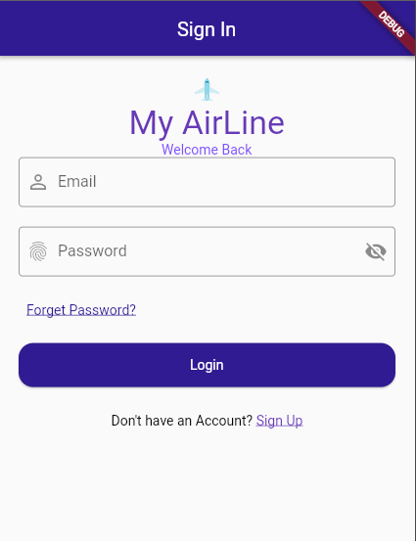
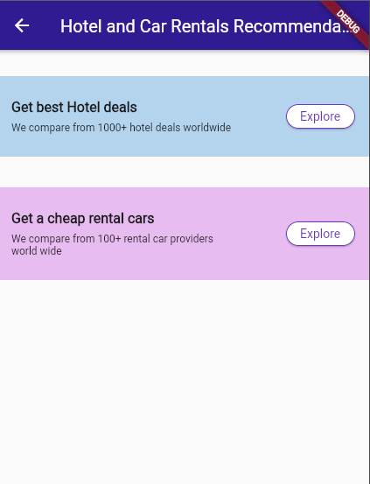
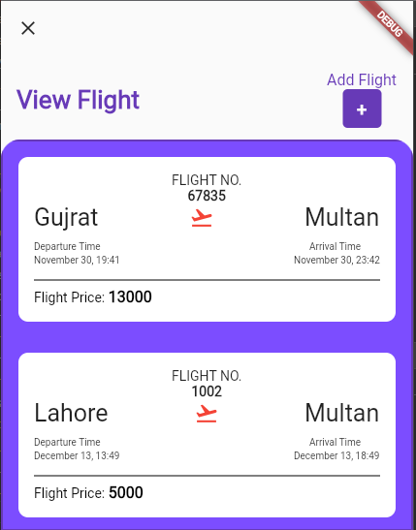
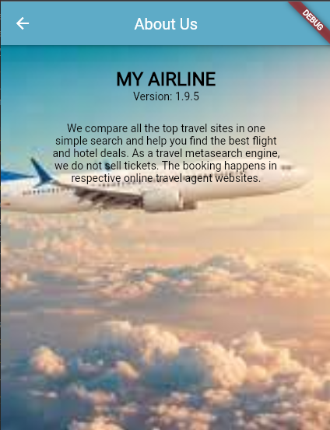
Wireframes

Slide 8
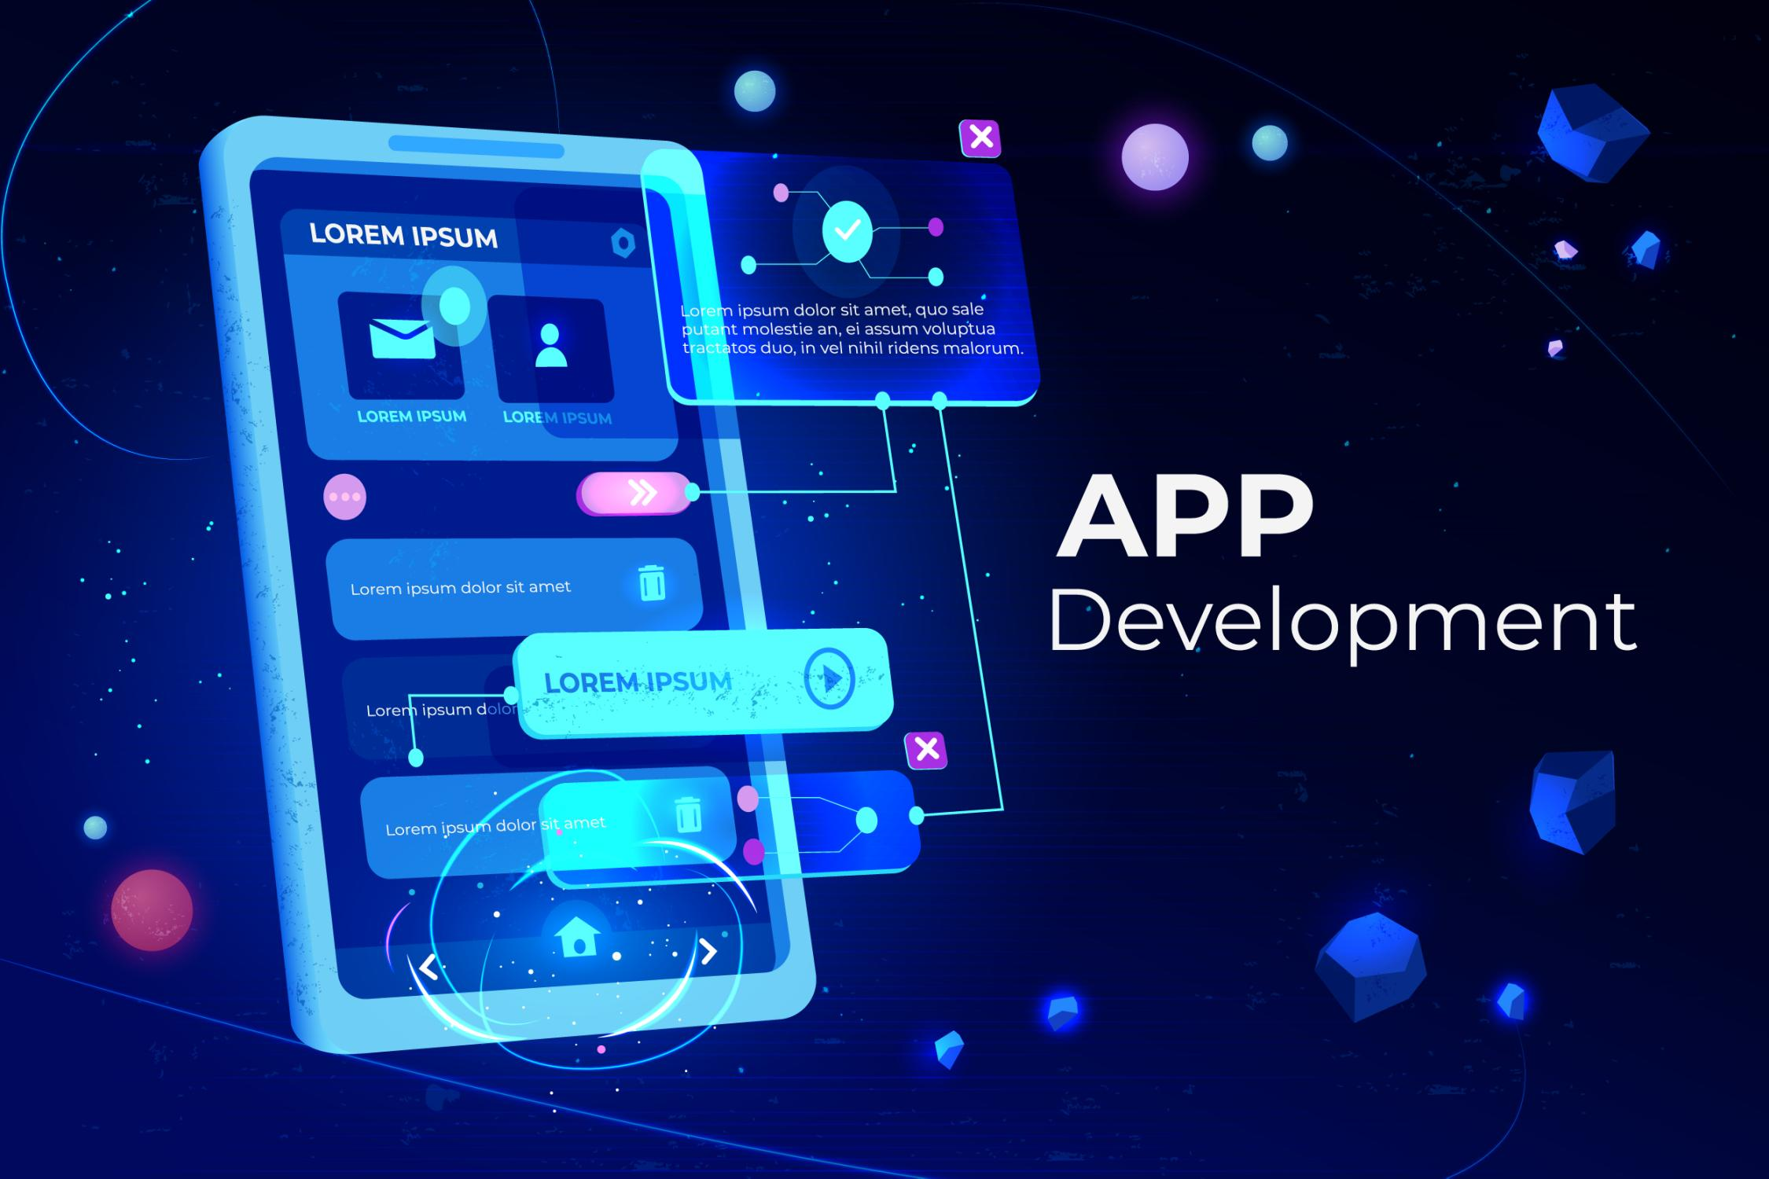
Front End Technology
Flutter (For UI)
Dart (For UI)

Slide 9

Back End Technology
Backend is done using Dart languages.
Models (Models View Controller)
Repositories (For BL)
Firebase (Database)

Slide 10
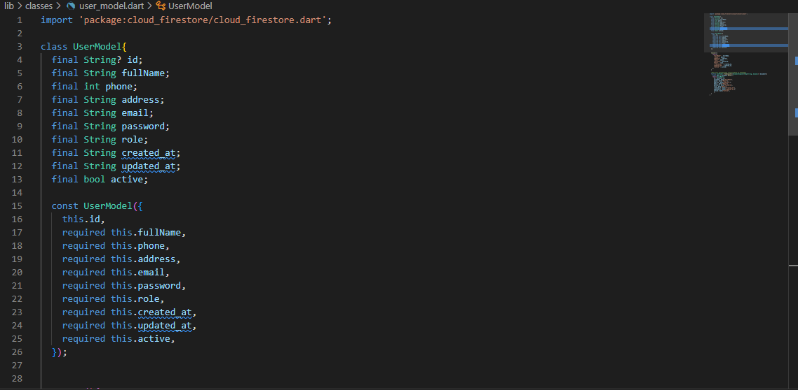
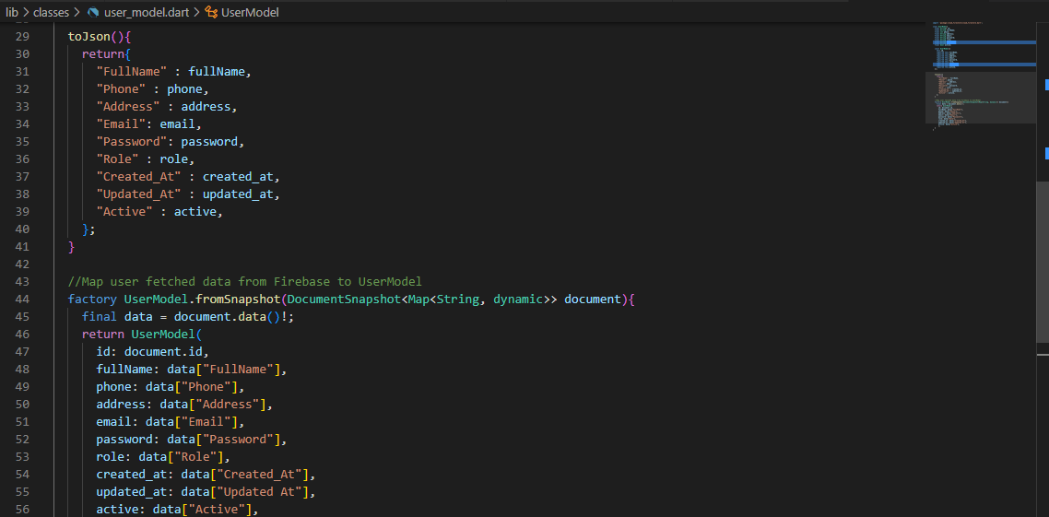
Coding Best Practice
Consistent Naming Conventions
Code Structure
Comments
Use of Variables
Readable

Slide 11

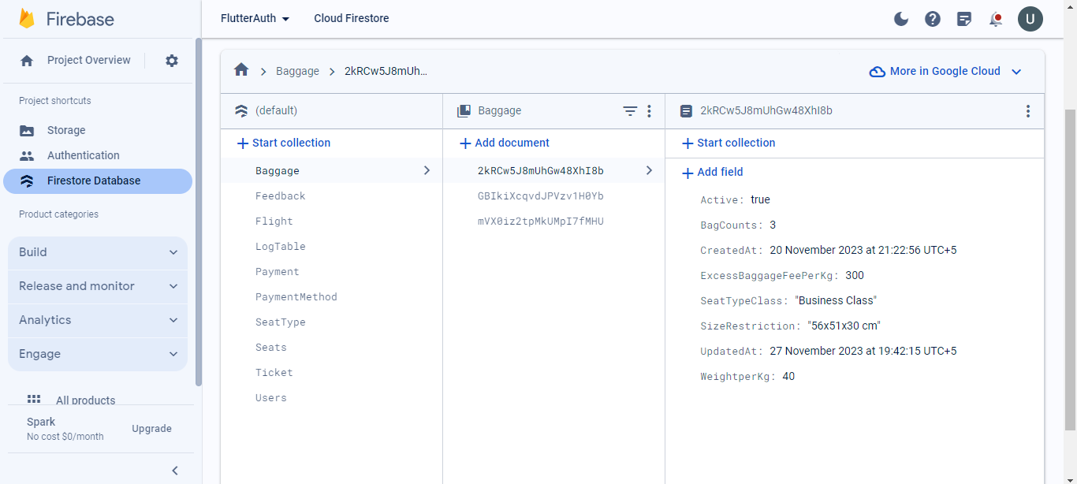
Database
Cloud Firebase
The Firebase Realtime Database is a cloud-hosted NoSQL database that lets you store and sync data between your users in realtime.

Slide 12
Project Features

Slide 13
Project Features
Admin:
Admin Login
Forget Password
Add Flight
Update Flight
View Flights
Add Seat
Update Seat
View Seats
Add Baggage
Update Baggage
Delete Baggage
View Baggage
View Feedback
View Tickets
View Offers

Slide 14
Project Features
Customer:
Customer Sign up
Customer Login
Forget Password
Send Email
View Profile
View Flights
Select Flights
View Seats
Select Seats
Buy Tickets
Checkout
Add Payment
Send Feedback
View Offers
Get discount on seats
View Baggage details
View Selected Tickets

Slide 15
Project Management Tools

Slide 16
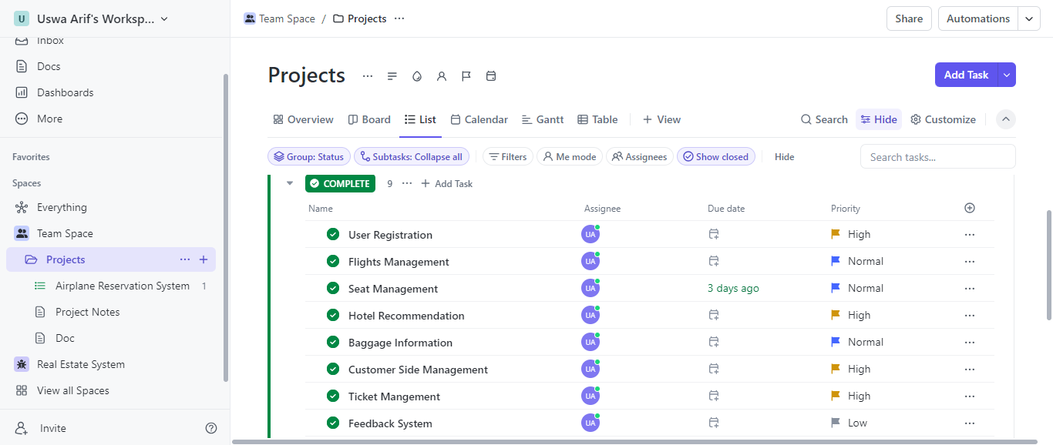
Click up (Project Management)

Slide 17
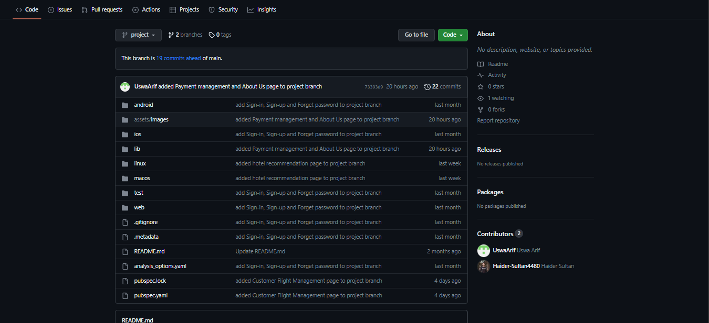
Github (Version Control System)

Slide 18
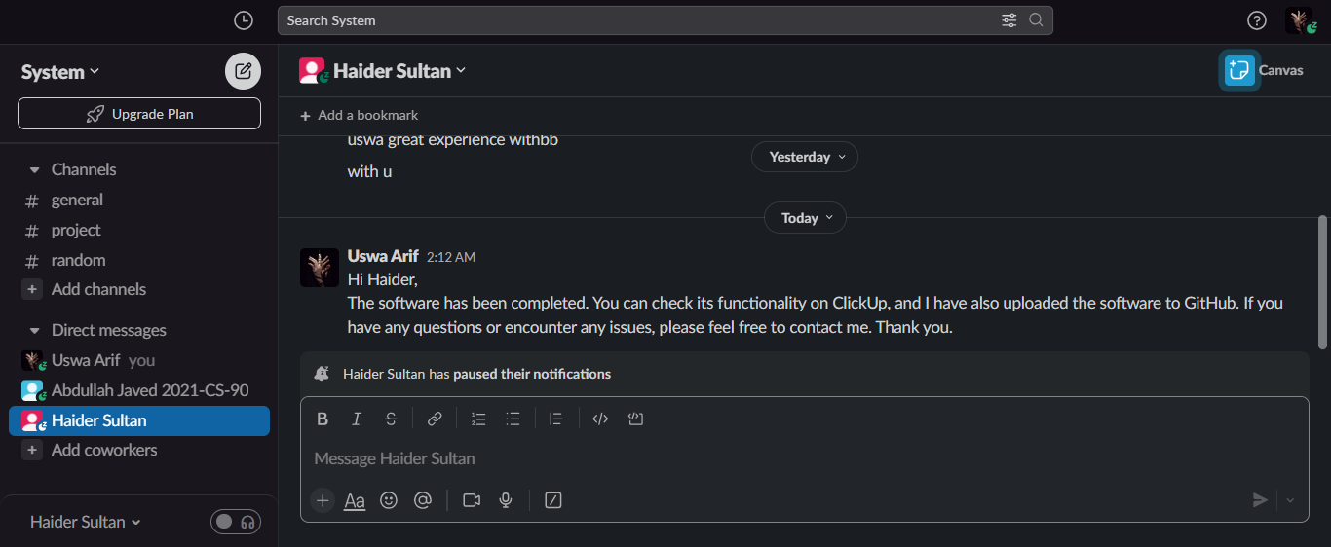
Slack (Clients Conversation)

Slide 19
THANK YOU

